Slide 1
CS 35L – Section 1
09/30/2013
Zhanyong Wang (Jerry)
zhanyongwang@ucla.edu
Office Hour:
BH2432
Tuesday 9:00-11:00

Slide 2
Course Information
What is this course?
Software Construction Laboratory

Slide 3
Course Information
Course organization
Lecture
In class lab

Slide 4
Course Information
What do we learn?
Unix/Linux based system
Commands and Scripting(shell)
Makefile, Version Control(Git)
Low-level construction and debug (Compile, link)
System programming (Library calls, system calls)
Faults, failures, errors, holes
Security

Slide 5
Course Information
Grading policy
50% Assignments(equally weighted)
50% Final exam
Late penalty
N: late days
2^{N}% of the assignment value
N: 0-1 1%
N: 1-2 2%
N: 2-3 4%
N: 3-4 8%
…
N: 7-8 128% == GET 0

Slide 6
Assignments
Laboratory
Expected to be done in class
Take log
Homework
Submission
Electronically on courseweb
Lab log, lab solution, homework solution

Slide 7
Hw1 and hw10
HW10: A research and development assignment
Brief research report
Presentation ~10 mins (may start from 5th week)
Email me your topic
HW1:
Lab1.log
Lab1.txt
Hw1.txt

Slide 8
Interacting with Computers - History
Switches and Lights
Batch Processing
Teletype - CLI
First printer, then monitor
GUI

Slide 9
Command Line Interface vs. Graphical User Interface
CLI
GUI
Steep learning curve
Pure control (e.g., scripting)
Cumbersome multitasking
Speed: Hack away at keys
Convenient remote access
Intuitive
Limited Control
Easy multitasking
Limited by pointing
Bulky remote access

Slide 10
Quick intro to GNU/Linux
http://www.ee.surrey.ac.uk/Teaching/Unix/unixintro.html
Sun solaris, GNU/Linux, MacOS
Free open source operating system
http://en.wikipedia.org/wiki/Linux
Popular server operating system
Android system

Slide 11
Primary access
Shell (command line)
Command line interpreter
Similar to DOS prompt in Windows
Input – commands
http://en.wikipedia.org/wiki/Unix_shell

Slide 12
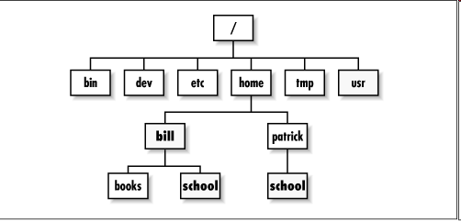
Directory structure
Folder in Windows = Directory in Linux
Linux - Home directory - /w/grad.5/cs/zhanyong/
You will have write permissions only in your HOME directory
Read permissions for most other files/directories
Everything is case sensitive

Slide 13
Which Linux?
Ubuntu Linux Distribution
Most popular as of 2012
Frequently updated, new release every 6 months
Simple installation and booting
Nice set of pre-installed packages

Slide 14
Options
1) On BH3760 Computers
Don’t install Ubuntu
Try Ubuntu
2) On your computer
Install or try Ubuntu
Run with Windows (https://wiki.ubuntu.com/WubiGuide)
Easy to remove Ubuntu from Windows via Control Panel, if you don’t need Ubuntu.

Slide 15
3) Virtual Machines
VMWare
Virtual Box
4) SEAS Server
lnxsrvXX.seas.ucla.edu
Username: SEAS ID
Password: SEAS password
On windows: putty or cygwin
On Mac: Terminal

Slide 16
Ubuntu Linux on BH3760 Computers
Click on “Try Ubuntu” Button
Every time we use Ubuntu trial mode
Need to install Linux tools we need to use
sudo apt-get install <package-name>
Example: sudo apt-get install vim
If above does not work
sudo apt-get update
sudo apt-get install <package-name>

Slide 17
Connecting to the SEAS machines
MacOS
Terminal
Windows
Third party software
Cygwin, Putty

Slide 18
Connecting to the Linux from MacOS
Terminal
Applications->Utilities->Terminal
ssh username@lnxsrv01.seas.ucla.edu
username = your SEASnet user name
SEASnet help desk on second floor of Bolter Hall

Slide 19
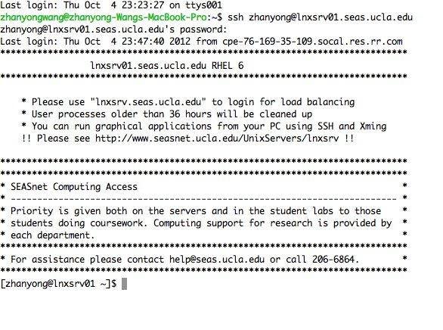
Terminal

Slide 20
Connecting to Linux from PC
Putty,Cygwin
Recommend Putty
Small and easy to use
Putty homepage: http://www.chiark.greenend.org.uk/~sgtatham/putty/
Download: http://the.earth.li/~sgtatham/putty/latest/x86/putty.exe
Host name = lnxsrv0x.seas.ucla.edu
Username = your SEASnet user name

Slide 21
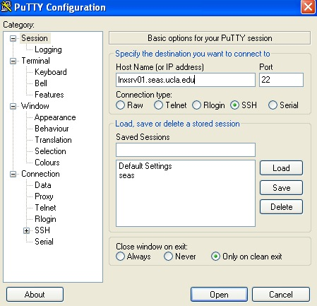
Putty

Slide 22
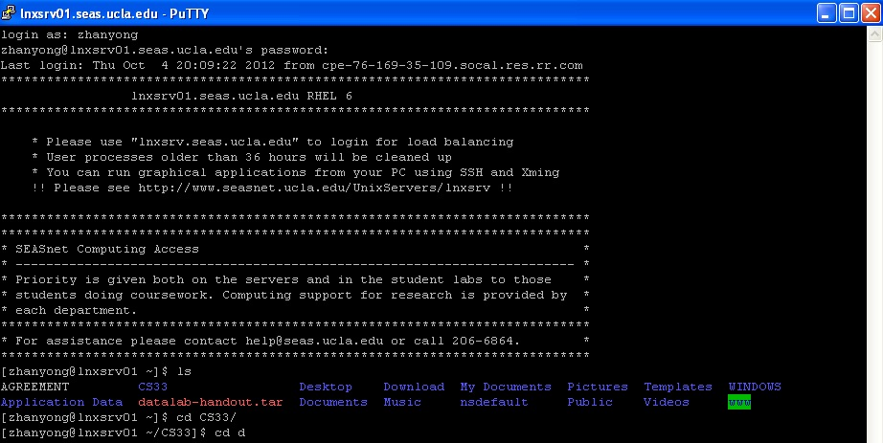
Putty

Slide 23
The Basics: Moving Around
pwd: print working directory
cd: change working directory
~: home directory
.: current directory
/: root directory, or directory separator
..: parent directory

Slide 24
Directory structure
Folder in Windows = Directory in Linux
Linux - Home directory - /w/grad.5/cs/zhanyong/
You will have write permissions only in your HOME directory
Read permissions for most other files/directories
Everything is case sensitive

Slide 25
The Basics: Dealing with Files
mv: move a file (no undos!)
cp: copy a file
rm: remove a file
r: remove directories and their contents recursively
mkdir: make a directory
rmdir: remove a directory
ls: list contents of a directory
d: list only directories
a: list all files including hidden ones
l: show long listing including permission info
s: show size of each file, in blocks

Slide 26
The Basics: Redirection
> file: write stdout to a file
>> file: append stdout to a file
< file: use contents of a file as stdin

Slide 27
The Basics: Links
ln: create a link
Hard links: point to physical data
Soft links aka symbolic links (-s): point to a file
touch: update access & modification time to current time
touch filename
touch -t 201101311759.30 filename
Change filename’s access & modification time to (year 2011 January day 31 time 17:59:30)

Slide 28
The Basics: History
<up arrow>: previous command
<tab>: auto-complete
!!: replace with previous command

Slide 29
man
Extensive documentation that comes preinstalled with almost all substantial Unix and Unix-like operating systems
Usage
read a manual page for a Unix/Linux command
man <command_name>
man section command_name
Hit “q” to get out of man page.

Slide 30
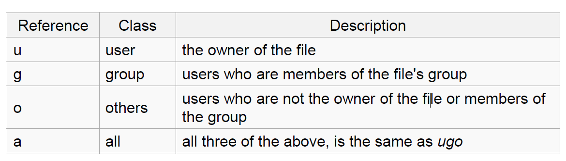
Linux Permissions
chmod
read (r), write (w), executable (x)
User, group, others

Slide 31
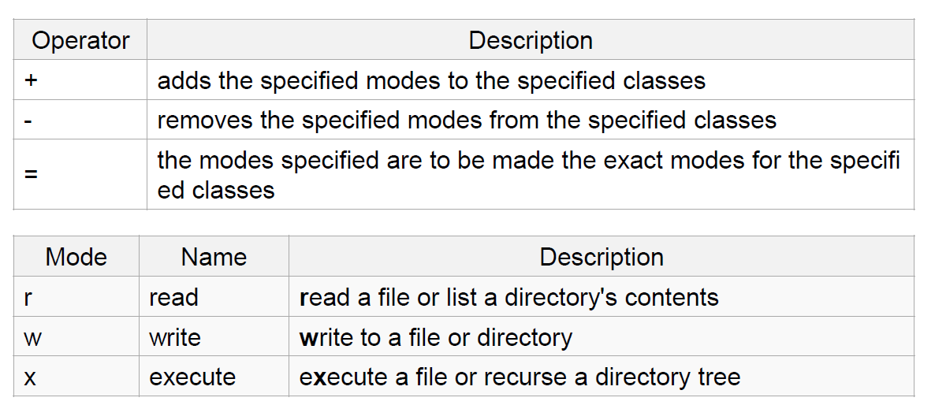
The Basics: chmod

Slide 32
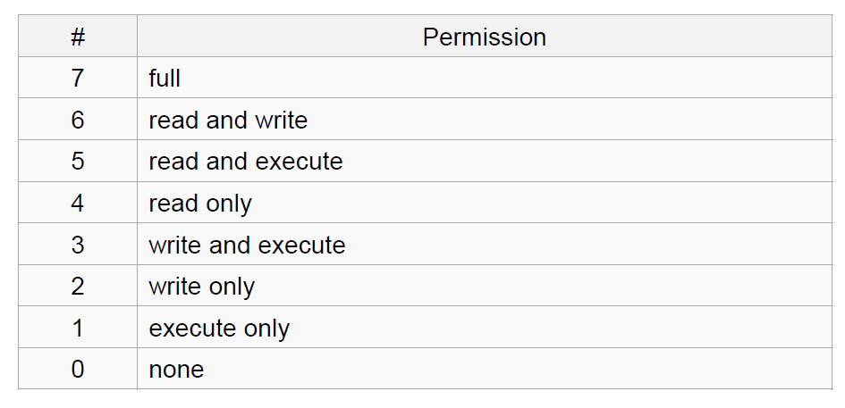
The Basics: chmod
Usage
– chmod [''references''][''operator''][''modes''] ''file1'' ...
Example: chmod ug+rw mydir, chmod a-w myfile,
Example: chmod ug=rx mydir, chmod 664 myfile

Slide 33
The Basics: find
-type: type of a file (e.g: directory, symbolic link)
-perm: permission of a file
-name: name of a file
-prune: don’t descend into a directory
-ls: list current file

Slide 34
File Name Matching
?: matches any single character in a filename
*: matches one or more characters in a filename
[]: matches any one of the characters between the brackets. Use ‘-’ to separate a range of consecutive characters.

Slide 35
find Examples
Examples
find . -name my*
find . -name my* -type f
find / -type f -name myfile –print
find / -path excluded_folder -prune -o -type f -name myfile –print

Slide 36
wh… Commands
whatis <command>: returns Name section of man page
whereis <command>: locates the binary, source, and manual page files for a command

Slide 37
Editors

Slide 38
Vim (Vi)
text only text editor
Efficient
To run: type(without quotes) “vim”
vim tutorial
http://www.linuxconfig.org/Vim_Tutorial

Slide 39
vi
Modes:
Normal: Enter commands
Insert: Insert text
Visual: Like normal, but you can highlight
Replace: Like insert, but you replace characters as you type
Recording: Record a sequence of key sequences

Slide 40
Vi Command
Insertion mode
i: insert before cursor
Esc: exit insertion mode
Command mode
:q quit without change
:q! quit without saving
:w save

Slide 42
Emacs
Almost like a Windows text editor, but much more powerful
IMHO, easier to use than vi

